Slide 1


Name of Member
Name: Varun Shirish Marulkar

Slide 2

Project Leadership
Sharat Manikonda
Director at Innodatatics and Sponsor
linkedin.com/in/sharat-chandra

Slide 3
Contents
Business objective
Business Constraints
Project Architecture
Data collection and details
Exploratory Data Analysis
Visualization
Notes:
Change

Slide 4
Business Problem
Unplanned Failure In Wind Turbine Engine is leading to huge losses and electricity generation is negatively impacted.

Slide 5
Business Objective: Minimized Unplanned Failure.
Business Constraint: Maximize Power Generation

Slide 6







Project Overview and Scope
Data Sources
Data Pre-Processing
Location Data
Vendor Report
Cleaned Data
RAW Data
Operator
Scada
Environment Data
Visualization
Power BI service
Collection of data and store it in database form
Power BI Tool

Slide 7
Data Dictionary
Data Dimension: 2900*14
Features | Range | Description
Wind speed (m/s) | 2 m/s (144 km/h, 89 MPH) to 72 m/s (259 km/h, 161 MPH) | The survival speed of commercial wind turbines. Wind speed describes how fast the air is moving past a certain point.
Power (kW) | 2 MW and 3.5 MW. | Power output of wind turbine. Wind power describes the process by which the wind is used to generate mechanical power or electricity.
Nacelle ambient temperature (Â°C) | -20°C to 40°C | level of temperatureon ground. they must withstand a wide range of ambient temperature
Generator bearing temperature | 70 °C to 100°C | temperature of the bearing in generator. Bearing temperature shall not exceed 65°C under 30°C cooling water.
Gear oil temperature | 50 c to 90 c | gearbox oil temperature. Oils operating at high temperature require good viscosity and high resistance to oxidation and foaming.
Ambient temperature | 10°C to 57°C | level of temperatureon ground. Ambient temperature is the air temperature of any object or environment where equipment is stored.
Rotor Speed | 50-300 RPM | Rotational speed of a wind turbine rotor about its axis. Part of the turbine's drivetrain, the low-speed shaft is connected to the rotor and spins between 8–20 rotations per minute.
Nacelle temperature | 30°C to 60°C | temperature of the oil in generator. wind turbine nacelle is that they must withstand a wide range of ambient temperature.
Bearing Temperature | 70 °C to 100°C | The temperature of the bearing in degrees Celsius. Bearings in steam turbines will normally operate at temperatures below 180 degrees Fahrenheit.
Generator Speed | 1000 to 1800 rpm | The rotational speed required by most generators to produce electricity. a speed that allows the turbine's generator to produce AC electricity.
yaw angle | 0 to 60 Degree | The position of the yaw angle degrees. used to turn the wind turbine rotor against the wind.
Wind direction | 0 to 90 Degree | The direction of the wind in degrees.
Wheel hub Temperature | -40 °C to 80°C | The wheel hubs house the bearings that support the main shaft and blades of the wind turbine
Gear box inlet temperature | 40°C to 60°C | The gearbox inlet temperature is the temperature of the air or fluid entering the gearbox.

Slide 8
Exploratory Data Analysis [EDA]
1.EDA is a process of investigating data to learn about its properties, spot unusual patterns, and test hypotheses. It uses statistical summaries and data visualizations to help us understand the data and make informed decisions.
2. EDA is the first step in data analysis, where we explore the data to learn about its patterns, relationships, and anomalies
3. There were 0 duplicate rows in the dataset.
4.There were missing values in 7 columns in the dataset as follows:
Wind Speed= 20 missing values
Power= 20 missing values
Nacelle ambient temperature= 6 missing values
Nacelle temperature=6 missing values
Generator speed=18 missing values
Yaw angle= 26 missing values
Gear box inlet temperature= 3 missing values
5.Outliers were found in every column except Wheel hub temperature
6.Outlier treatment was performed on all columns except Wheel hub temperature
Notes:
EDA is used for seeing what the data can tell us before the modeling task.
Change

Slide 9
Data Preprocessing
The data was first cleaned by checking and correcting the data types, filling in any missing values. Then, outliers were detected and removed. Finally, the distribution of the data was normalized to make it more suitable for machine learning analysis.
1. Data type correction: The data types of all attributes were checked and corrected, if necessary.
2. Missing value imputation: Missing values were imputed using the mean imputation method.
3. Outlier detection: Outliers were detected in each attribute by using Z-Score Method..
4. Outlier treatment: Outliers in the identified columns were treated using the Winsorization method.
5. Data distribution normalization: The distribution of data in each attribute was normalized using techniques such as log transformation.
Notes:
Keep observations

Slide 10
Descriptive Analysis
Notes:
Keep observations

Slide 11
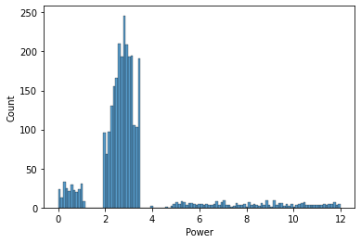
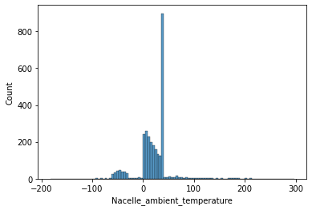
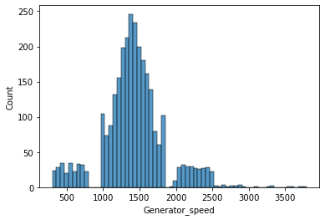
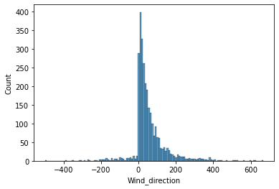
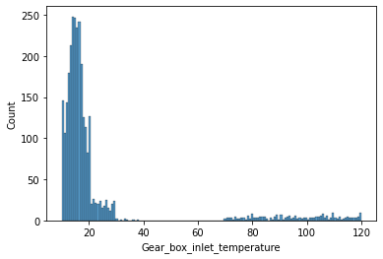
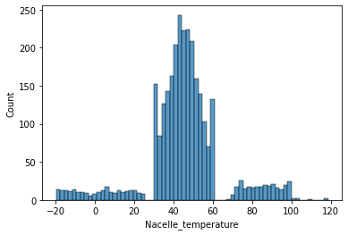
Histogram Before Preprocessing
Histogram of Nacelle ambient_temperature
Histogram of power
Histogram of Generator speed
Histogram of Nacelle temperature
Histogram of Gear_box_inlet_temperature
Histogram of Wind_direction

Slide 12
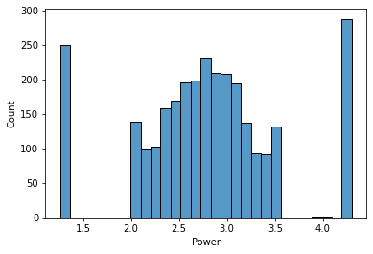
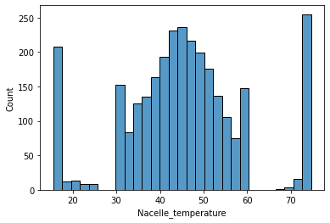
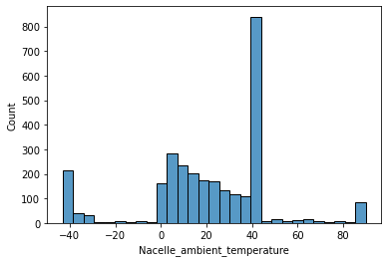
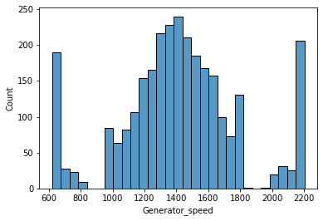
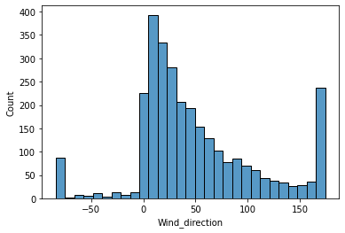
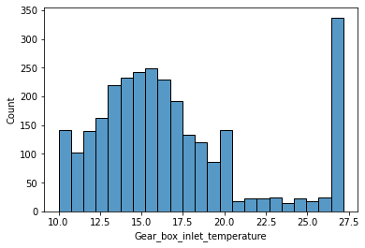
Histogram After Preprocessing
Histogram of Nacelle temperature
Histogram of power
Histogram of Nacelle ambient temperature
Histogram of Gear box inlet temperature
Histogram of Generator speed
Histogram of Wind direction
Notes:
Keep observations

Slide 13
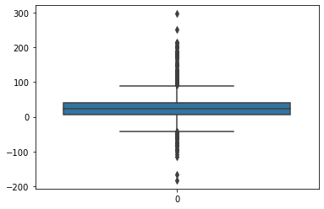
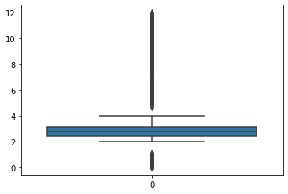
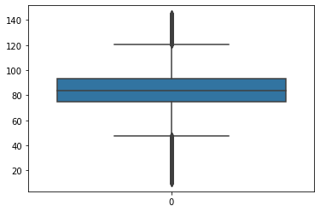
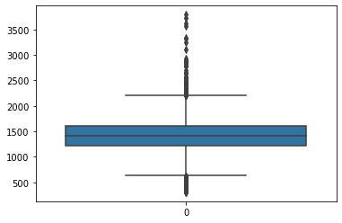
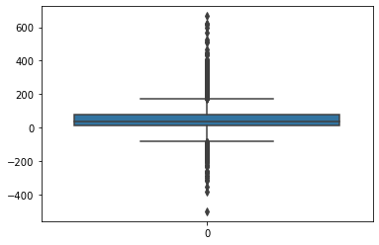
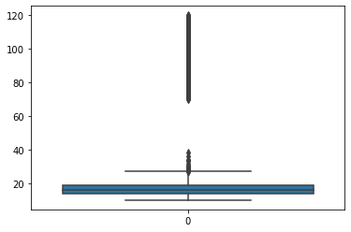
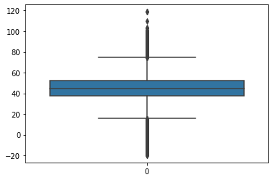
Box Plot Before Preprocessing
Box plot Generator bearing temperature
Box plot of power
Box plot of Nacelle ambient temperature
Box plot of Wind direction
Box plot of Generator speed
Box plot of Gear box inlet temperature
Box plot Nacelle_temperature

Slide 14
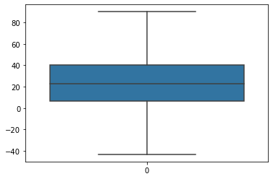
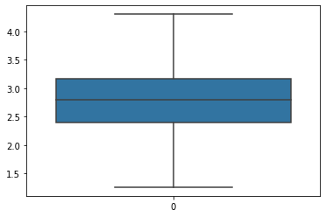
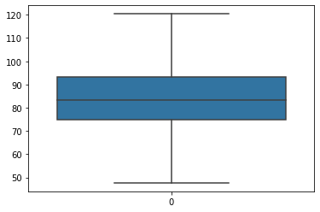


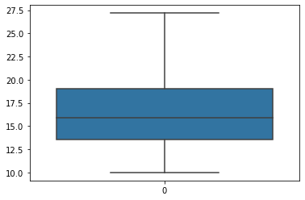

Box Plot After Preprocessing
Box plot of Nacelle ambient temperature
Box plot of power
Box plot of Generator_bearing_temperature
Box plot of Generator speed
Box plot of Gear box inlet temperature
Box plot of Wind direction
Box plot Nacelle temperature
Notes:
Keep observations

Slide 15
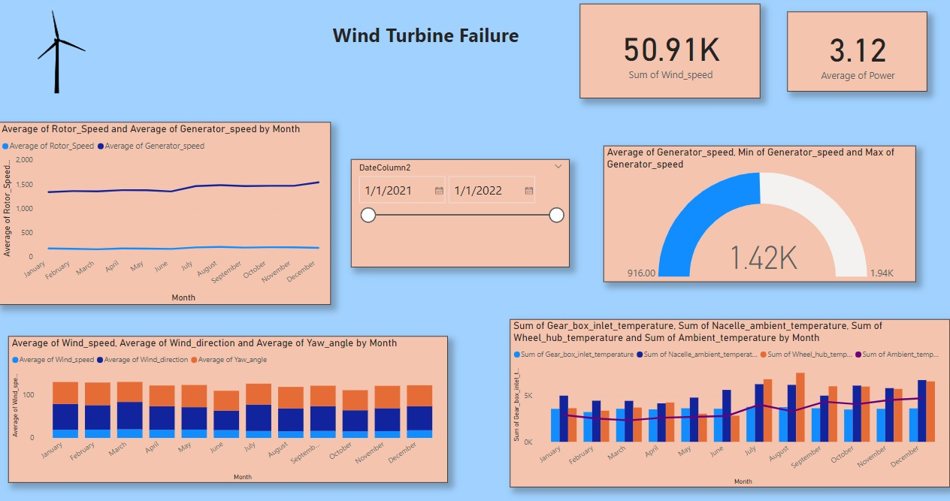
Data Visualization 1
Notes:
Add graphical

Slide 16
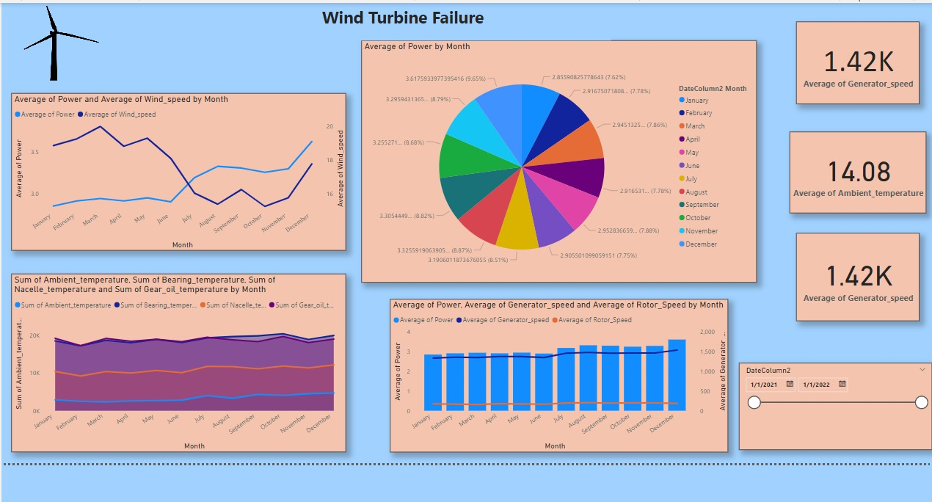
Data Visualization 2
Notes:
Add graphical

Slide 17
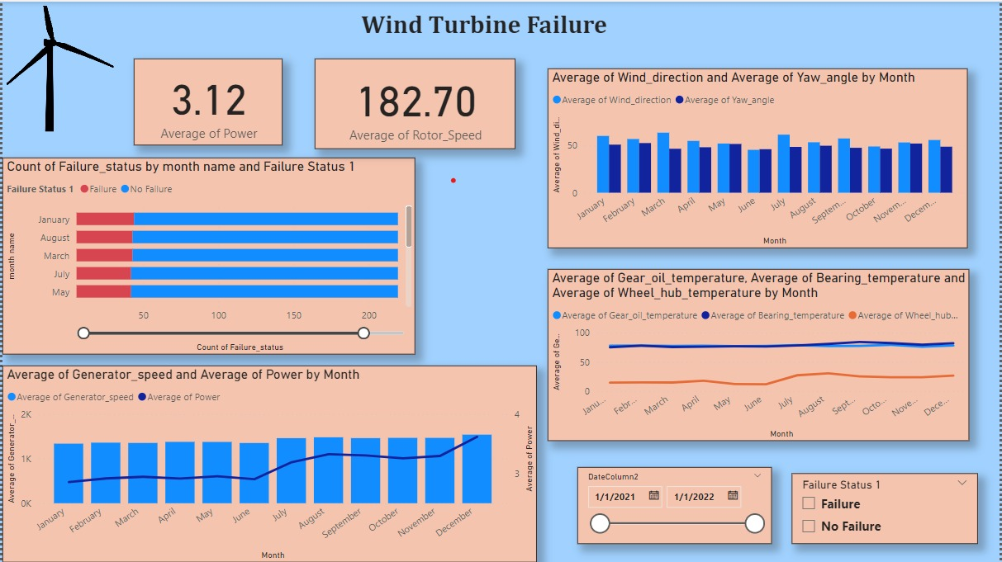
Data Visualization 3
Notes:
Add graphical

Slide 18


